Slide 1
Coffe shop – delivery database
CS50’s introduction to DATABASES WITH SQL

Slide 2
Who am i?
And what have
I achieved?
The implementation of an SQL Database via both MYSQL and SQLite for the backend support of a coffee shop’s delivery system. In this database workdays, orders, items (coffees, foods, beverages etc), addresses, customers and offers are tracked and stored. The data entry is implemented via a Python-MYSQL connector and Python’s tKinter (GUI Design) as the “Front-End” library.
Name: Antonios Roussos
GitHub username: Roussanto
EdX username: roussanto
Country: Greece
City: Athens

Slide 3
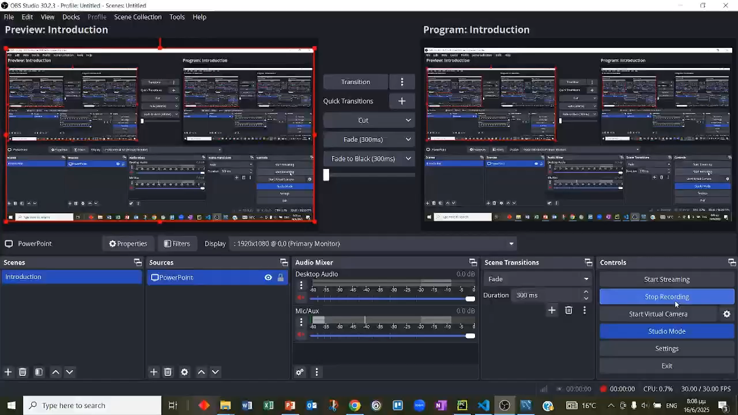
PROGRAM EXECUTION

Slide 4


